Slide 1

Game Night
Invite
adorn
Dance

Slide 2
Goal of Project
Test collaboration
Play with GIT - merge and rebase
Play with .md files (.py - optional)
Build final Project
Have first open source contribution

Slide 3
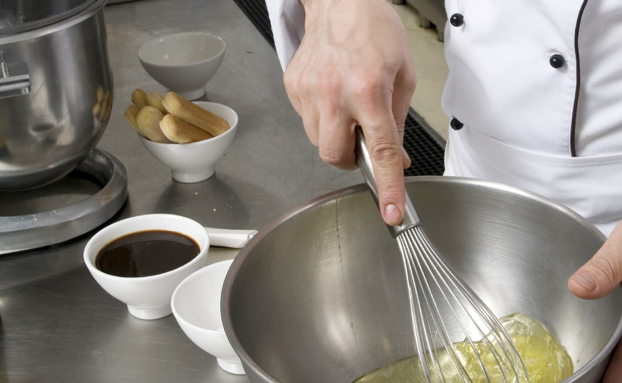
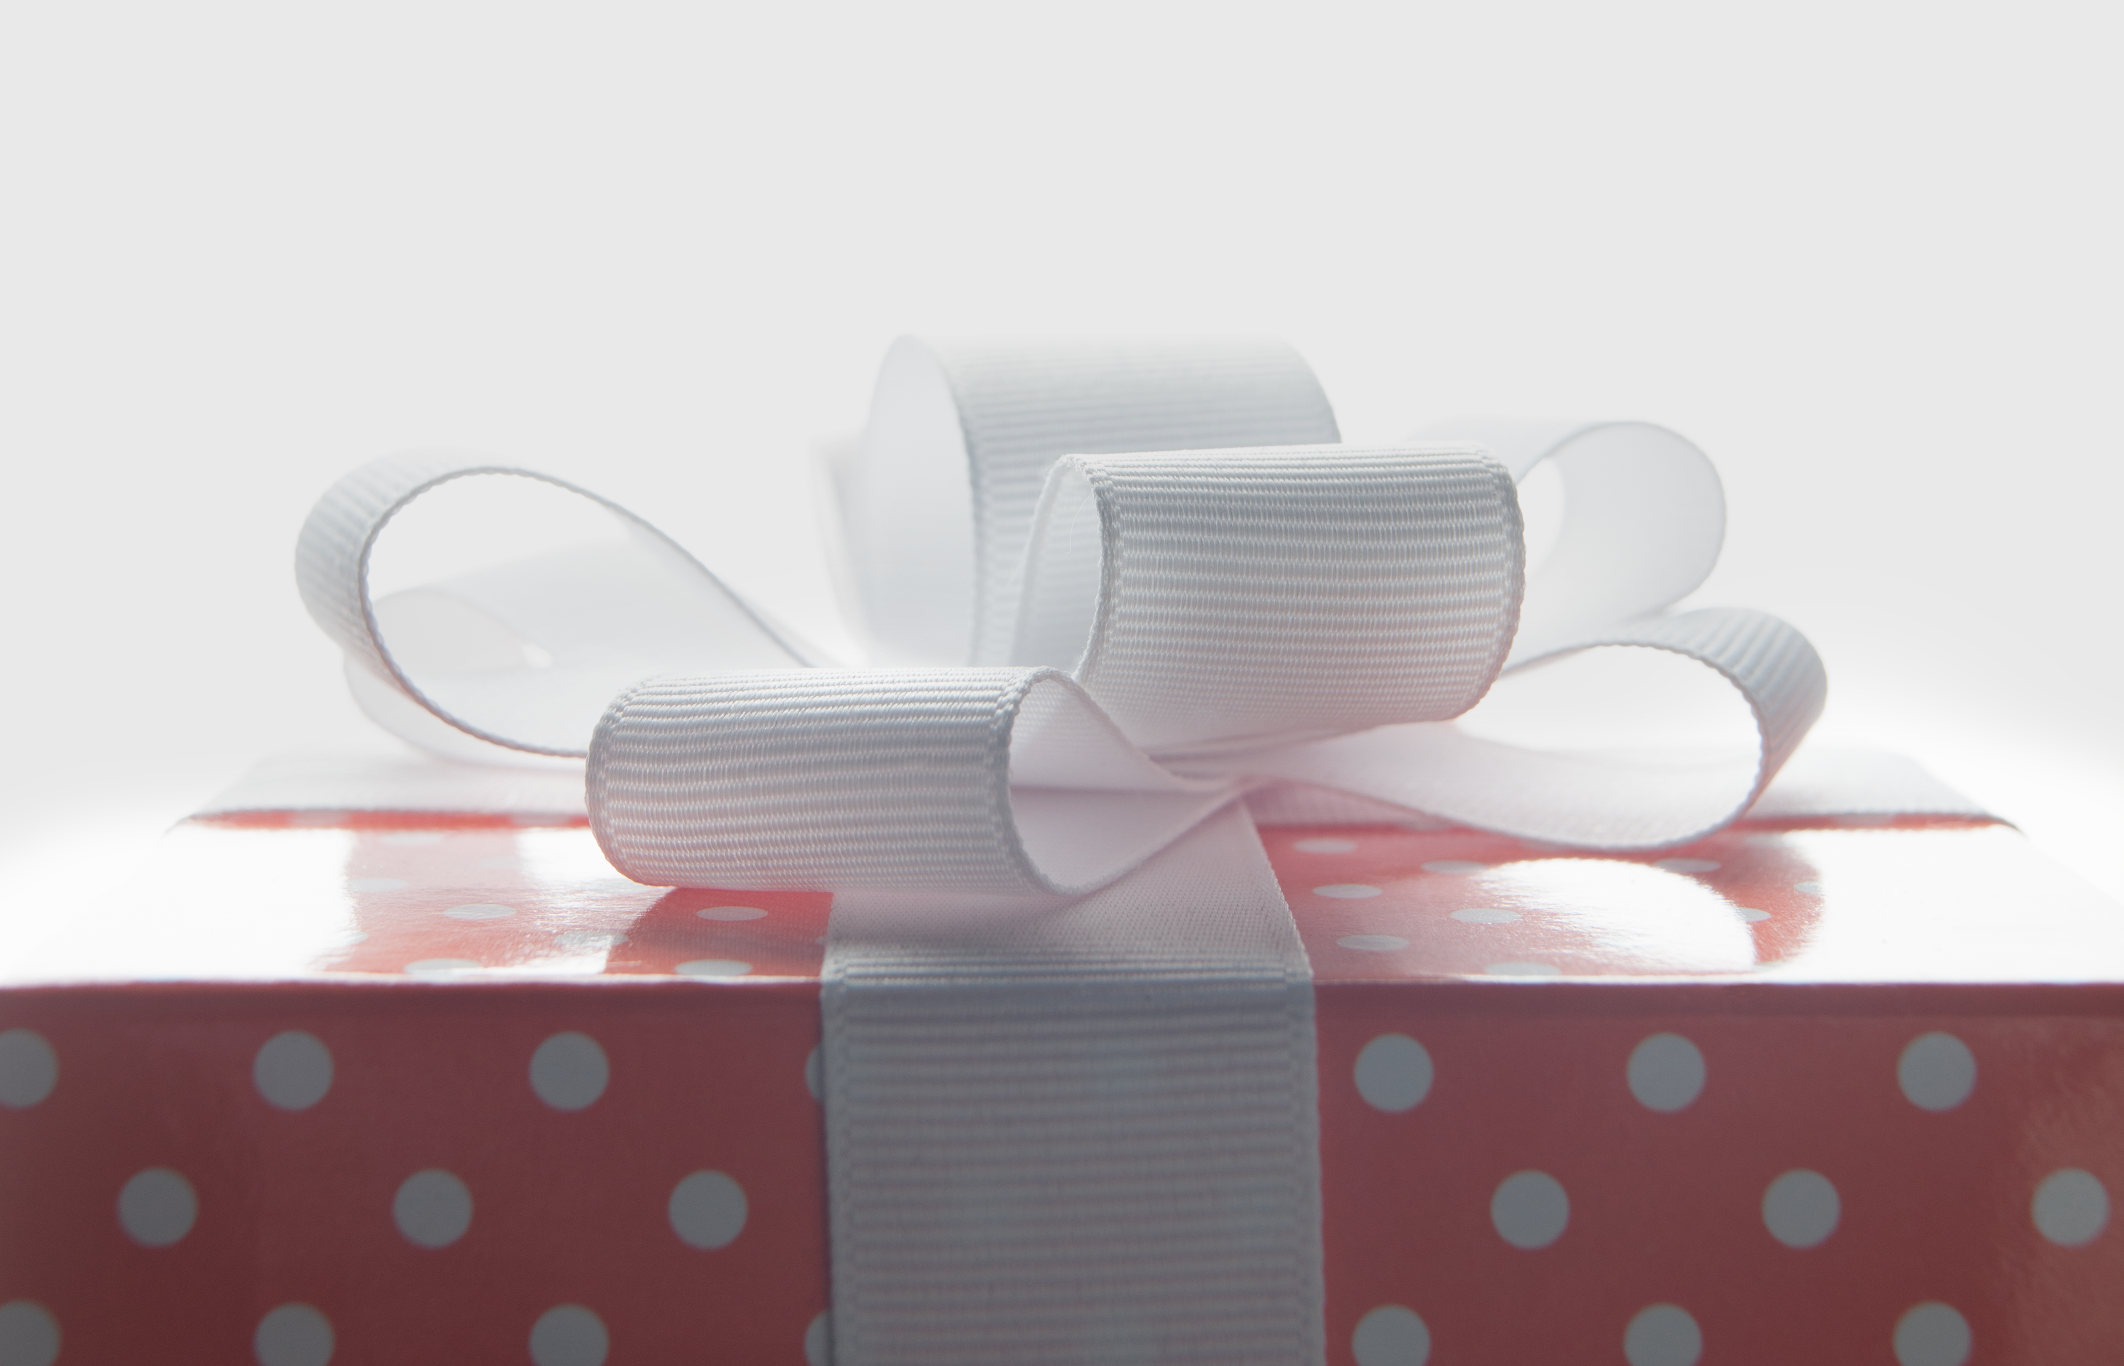
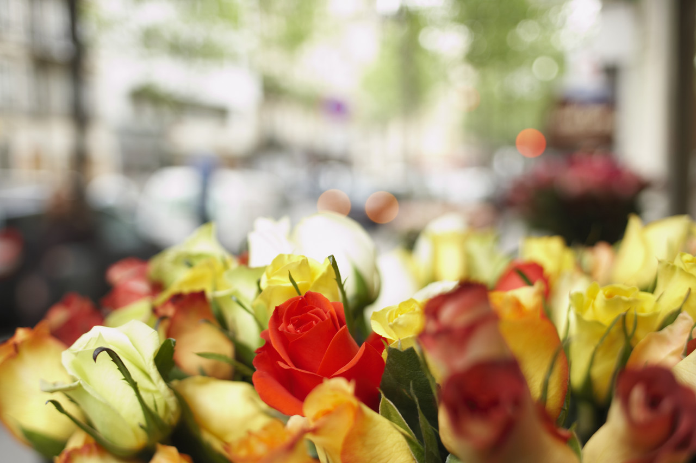
Task Pool (Technical and functional requirements)
Games (explanation + YouTube link)
Sort-hat algorithm
Sort-hat GUI
Display page designs

Slide 4
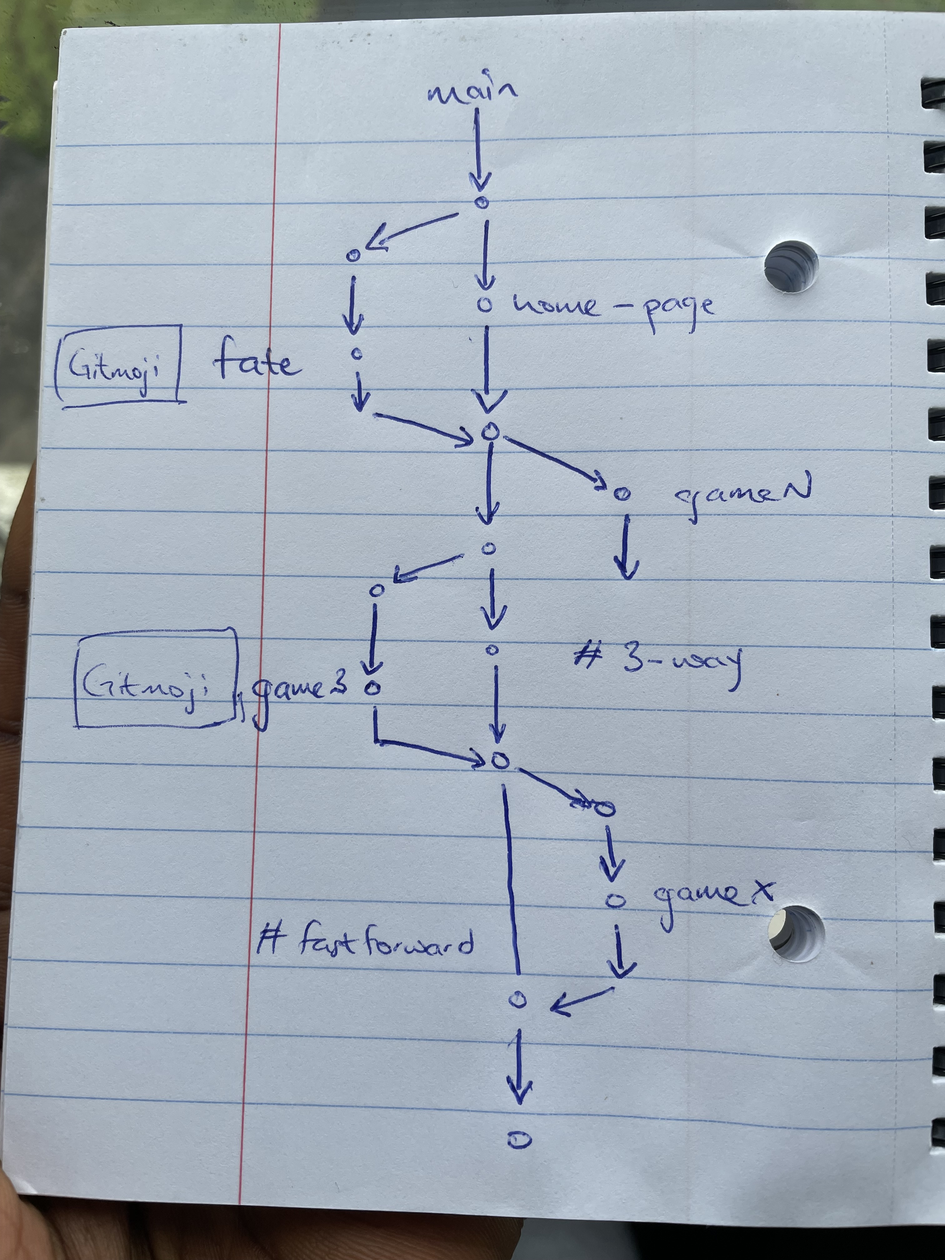
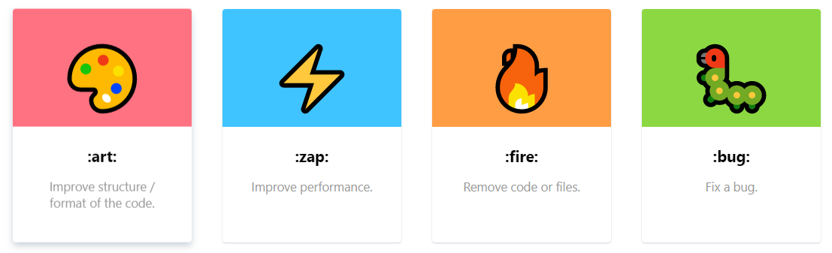
Approach
Branch out of main with each game
- Aim for simplistic explanation
- Provide YouTube link, if need be
- Overall display will come from consensus (design)
Rebase on game-branch with changes
Make pull request to main once done

Slide 5
Resources
Gitmoji: gitmoji | An emoji guide for your commit messages
Markdown cheat sheet: Markdown Cheatsheet · adam-p/markdown-here Wiki (github.com)
Git-Merge (3-way / fast forward): Git Merge | W3Docs Online Git Tutorial
Rebase video: Rewriting Git History - Amend, Reword, Delete, Reorder, Squash and Split - YouTube
Fork-Pull-Merge video: 1.3: Forks and Pull Requests - Git and GitHub for Poets - YouTube

